Slide 1
Antler Orogeny and Foreland Basin: A Model
R. C. Speed and N. H. Sleep
1982
Presented by James McNeil

Slide 2
Antler Orogeny
Late Devonian to mid-Early Mississippian
Passive margin of North American continent likely in Nevada and Idaho
Focus on the tectonic enclave of central Nevada

Slide 3
Principal Events of the Antler Orogeny
Displacement of oceanic strata in the Roberts Mountains allochthon up to 140 km toward the early Paleozoic shelf
Subsidence of an elongate foreland basin
Maintenance of highlands in the interior region of the allochthon following subsidence of the foreland basin
Antler orogeny doesn’t appear to have been accompanied by a thermal event or major crustal shortening

Slide 4
Basic Problems of the Antler Orogeny
The tectonics that initiated it
Mechanisms for thrusting oceanic strata ~4 km vertically and tens of km laterally
Reasons for subsidence of the foreland basin and apparent coupled uplift with a hinterland to the west

Slide 5
Post-Antler Tectonism
Four Phases
Late Paleozoic deformation, uplift and removal of the Roberts Mountains allochthon between Winnemucca and Elko
Golconda allocthon emplaced above Robers Mountans allochthon (little to no deformation of sub-Golconda rocks)
Jurassic and Cretaceous deformation of the Cordilleran thrust and fold belt
Cenozoic Basin and Range tectonics causing extension of 10%-20% in a west or northwest direction in central Nevada (width of Roberts Mountains allochthon in central Nevada was initially 15-30 km less)
Mesozoic foreland thrusting is the main source of disturbance of Antler orogenic features throughout the central Cordillera except in the tectonic enclave in central Nevada

Slide 6
Tectonic Enclave of Central Nevada
Focus of the study
Assumptions
Antler-related rocks are essentially unchanged from their Mississippian positions relative to the Paleozoic shelf
Eastern limit of lower Paleozoic oceanic rocks is the approximate trace of the Roberts Mountains thrust
If a Mesozoic decollement extends from eastern to western Nevada it exists within or below the lower Paleozoic shelf section

Slide 7
Thickness Curves
Two time divisions of thicknesses of foreland basin strata (Poole and Sandberg, 1977 and Stewart, 1980)
Not precise but suggest broadening of the basin over time and an increase in subsidence rates westward
Maximum subsidence rates cannot be determined based on poor preservation of beds in the west (1982)

Slide 8
Paleozoic Orogen
This paper: Presenting evidence to support the early view of mid-Paleozoic emplacement
Kinderhookian age of onset of subsidence of the Antler foreland basin and provenance of the bulk of foreland basin sediments from a western highland are lithologically like the Roberts Mountains allochthon
Overlap of Roberts Mountains allochthon above lower Paleozoic shelf strata and coincidence of present outcrop boundaries between them
Undeformed Triassic and late Paleozoic strata in central Nevada above the Roberts Mountains allochthon
W = water; O = oceanic crust; AP = accretionary prism

Slide 9
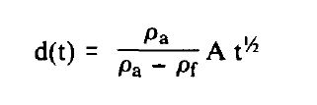
Initiation of the Antler Orogeny Arc-Continental Collision Model
Conceptual model of the collision of an Antler arc system and the western edge of sialic North America
Hypothesis of arc-continental collision model lacks evidence of an established Antler magmatic arc
Lack of Antler arc exposure can be explained by deep subsidence due to thermal contraction
W = water; O = oceanic crust; AP = accretionary prism
Rate of subsidence from thermal contraction: d-depth to basement, t-time after initial heating, p_{a}-density of asthenosphere, p_{f}-density of fill above contracting lithosphere, A-constant

Slide 10
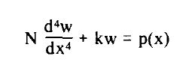
Conceptual Evolution of Antler Foreland Basin
Stage A – accretionary prism nearly submerged
Stage B & C – accretionary prism emerges above sea level
Stage C – elastic deflection of continental lithosphere and shedding of sediment toward the continent (eastward migration of prism)
Stage D – sedimentation decreases and shelf-like configuration is restored
Deflection of a thin elastic plate
N-flexural rigidity of the plate; w-vertical displacement; x horizontal distance; k-difference between specific weight between asthenosphere and basin fill material; g-gravity; p(x)-driving load per unit area
F = forearc basin; W = water

Slide 11
Calculated Flexure of the Lithosphere

Slide 12
Uplift in Front of the Thrust Sheet
No erosion is assumed to occur at times A, B, and C
Time D a region originally at sea level is uplifted by flexure and eroded back to sea level
The broad uplift may have produced an observable time-transgressive unconformity

Slide 13
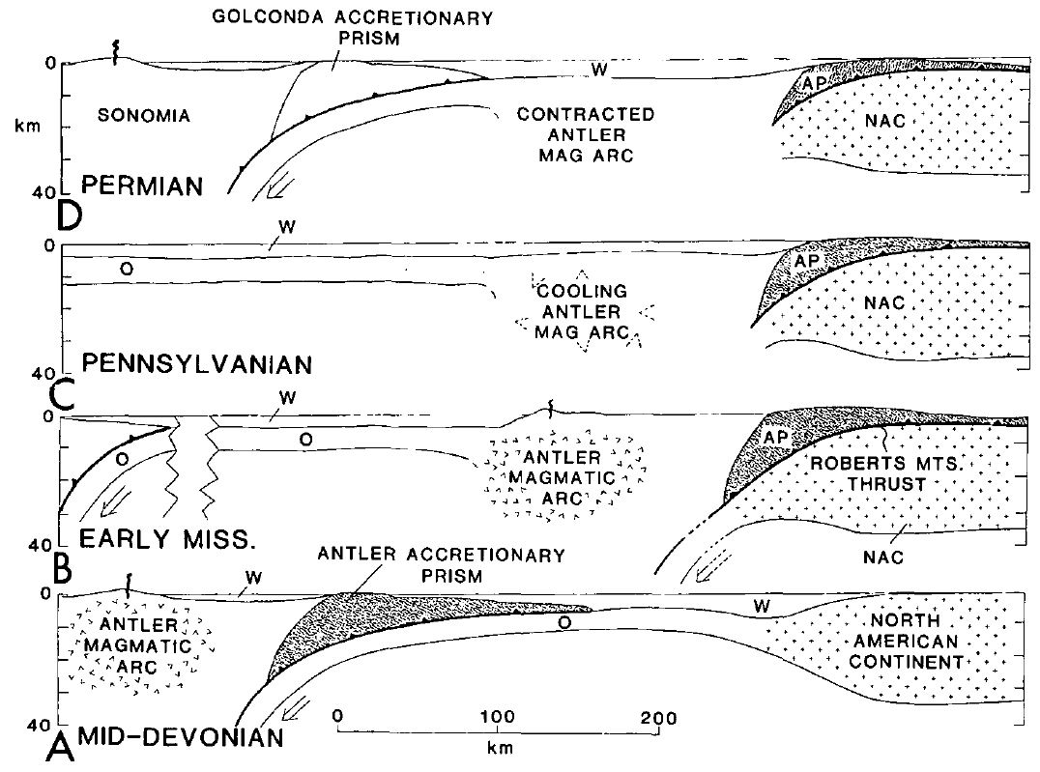
Conclusions
Model suggests initiation of activity for the Antler Orogeny was due to an arc-continental collisions and that the highland-foreland basin coupling was due to vertical loading of the continental shelf by a beached accretionary prism
Subsidence of Antler magmatic arc after collision due to thermal contraction
Initial Antler highlands were the subaerial part of the accretionary prism and
Deepest part of the foreland basin was at the toe of the prism
Flexural bulge up to 350 m preceded the migrating foreland basin
Take Home Point: Antler Orogeny occurred in the Mississippian as an arc-continental collision involving a large accretionary prism (Roberts Mountains allochthon) that was underthrust by a continental slope. The Antler magmatic arc was thermally contracted or subducted in a later arc collision (Triassic)

Slide 14
